Slide 1


QR automated registry
Fast, paperless staff transport registers for Corruseal Group
Prepared by NextQ
On behalf of Maponya and Moragi (Pty) Ltd
8 October 2026
Notes:
NextQ prepared this on behalf of Maponya and Moragi, the transport operator, for Corruseal Group. It explains QR mode, the passenger cards and how the records reach Corruseal.

Slide 2
Two modes, one register
TODAY
NEW
Standard register
QR mode
Passenger writes their line on the tablet
Signs with a finger at boarding and drop off
Best where a signature is required
Passenger shows a QR card, driver scans it
About two seconds per person, no typing
No phone, app or data needed by the passenger
The driver switches mode at any time. Both write the same register lines, so the PDF and Excel registers, the day reports and the security sign out confirmation stay exactly as they are.
Notes:
Nothing changes for Corruseal on the reporting side. QR mode is only a faster way to fill the same register.

Slide 3
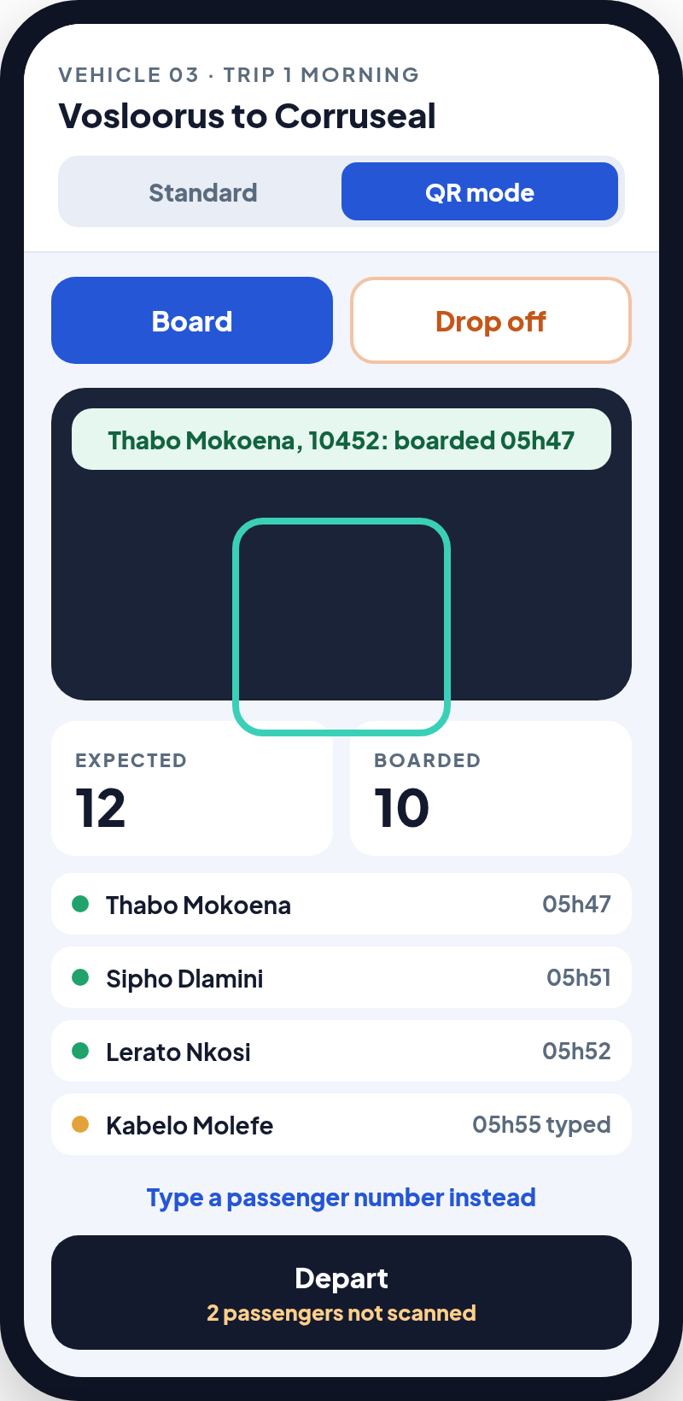
How QR mode works on the bus
1
Employee carries the card
Every Corruseal passenger gets a wallet size QR card.
2
Driver taps Board or Drop off
An explicit choice, so a second scan never flips someone the wrong way.
3
Scan, or type the number
Camera reads the card. A damaged card? The driver types the printed number.
4
The record is saved
Name, clock number, time, vehicle, trip and route, live for Corruseal.
Notes:
The driver app keeps a running count of expected and boarded passengers. At departure it warns about anyone on the list who has not been scanned.

Slide 4
Every scan creates a record
FIELD | EXAMPLE
Employee | Thabo Mokoena
Clock number | 10452
Date and time | 8 October 2026, 05h47
Action | Board (sign in)
Vehicle and driver | Vehicle 03, A. Maponya
Trip and route | Trip 1 morning, Vosloorus to Corruseal
Pickup point | Vosloorus, Ext 28 rank
How | Scanned (or typed in)
Nothing else to type
Each driver signs in once on their own vehicle.
The vehicle, trip, route and date come from the trip they started.
At drop off, the afternoon scan closes the same person's line with a time out.
Someone already on another bus cannot be boarded twice.

Slide 5
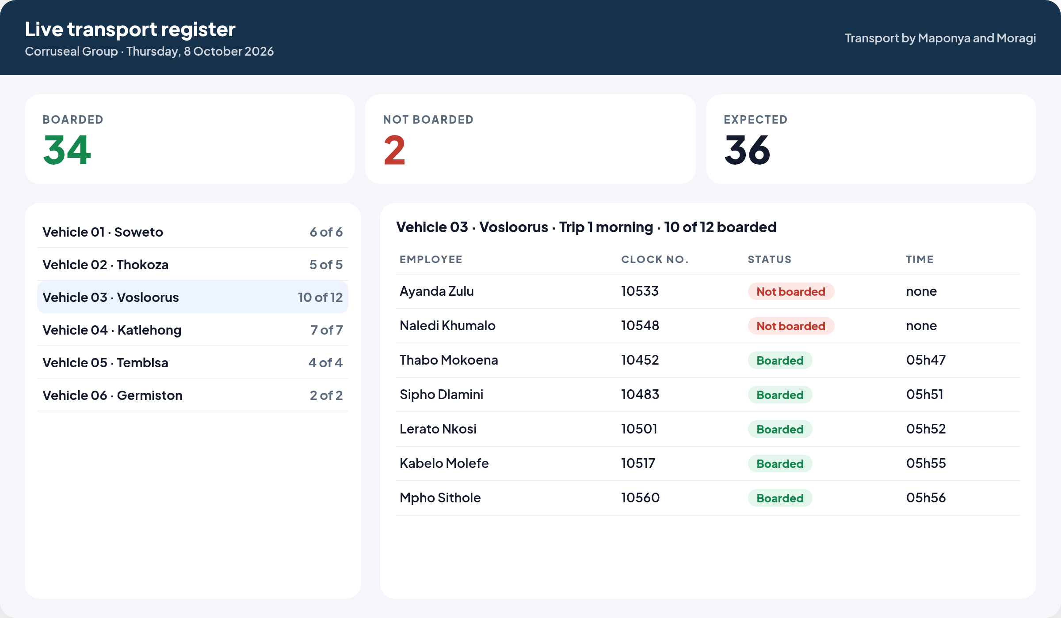
Corruseal sees every trip live
Boarded, not boarded, expected
For the whole day, per vehicle and per trip.
Click into any vehicle
Who boarded, at what time, and who is missing.
Same reports as today
PDF and Excel registers, emailed daily if wanted.

Slide 6
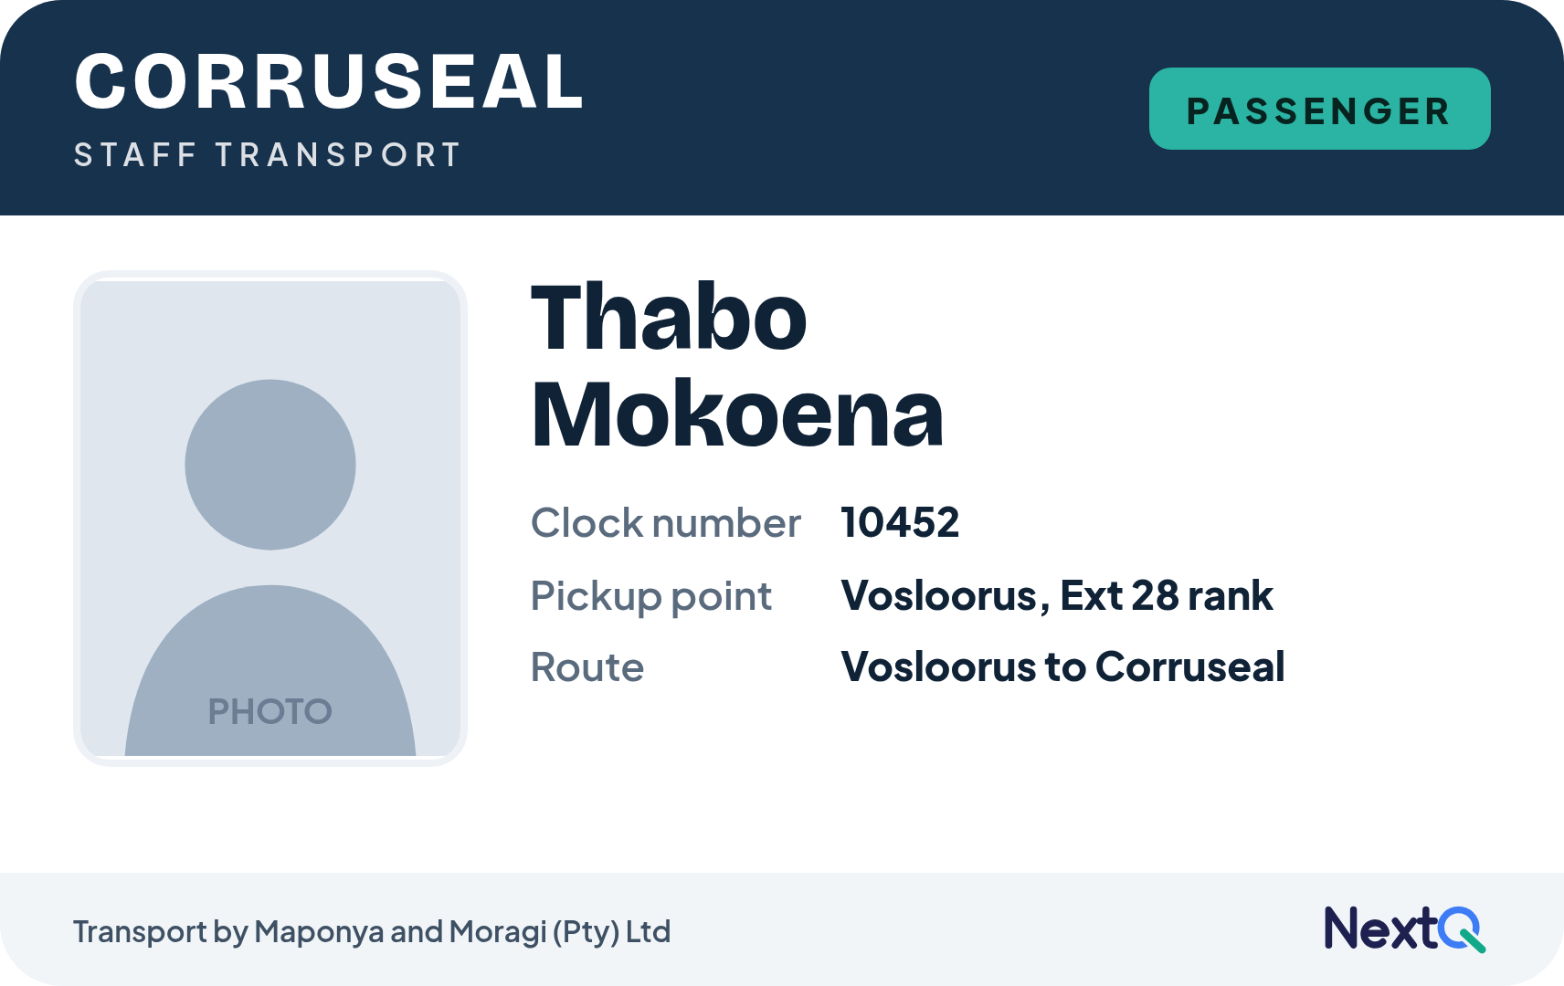
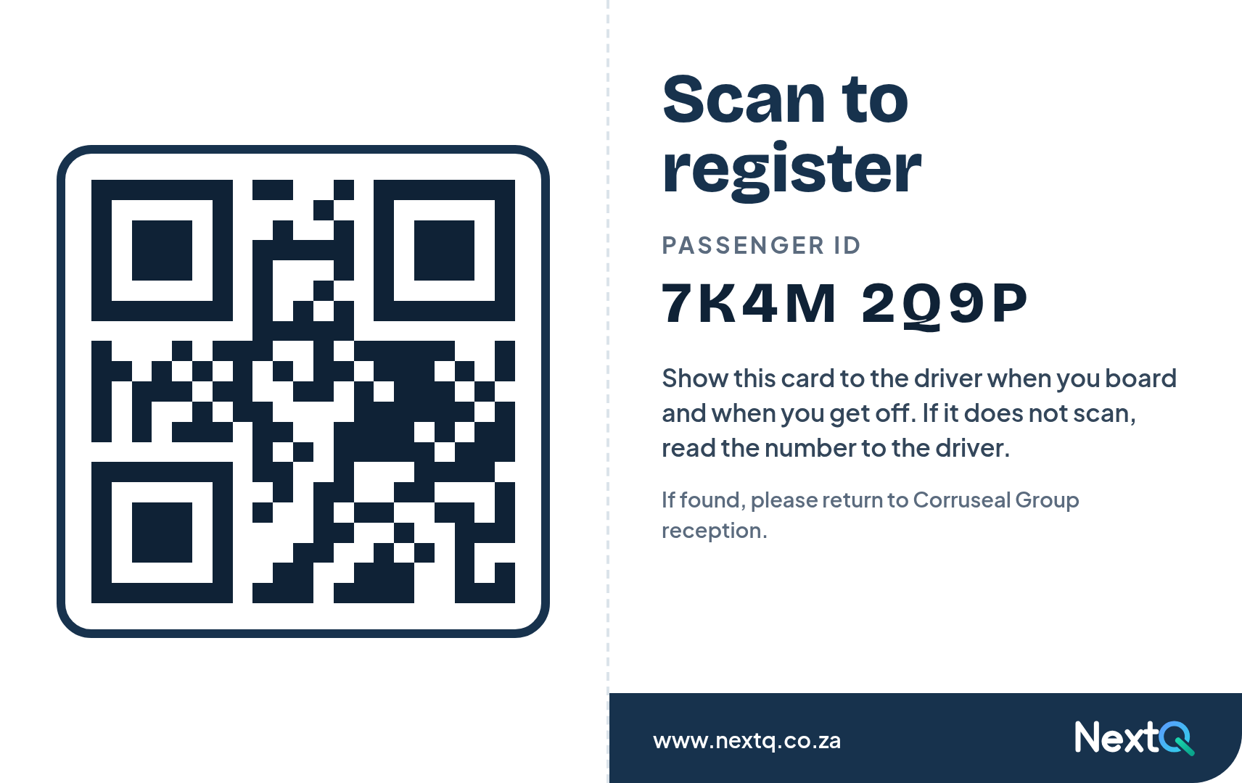
The passenger card, with photo
FRONT
BACK
Wallet size, landscape: 85.6 × 54 mm, the size of a bank card, so it fits a wallet, a lanyard or a card holder. Corruseal's own logo and colours go on the front.

Slide 7
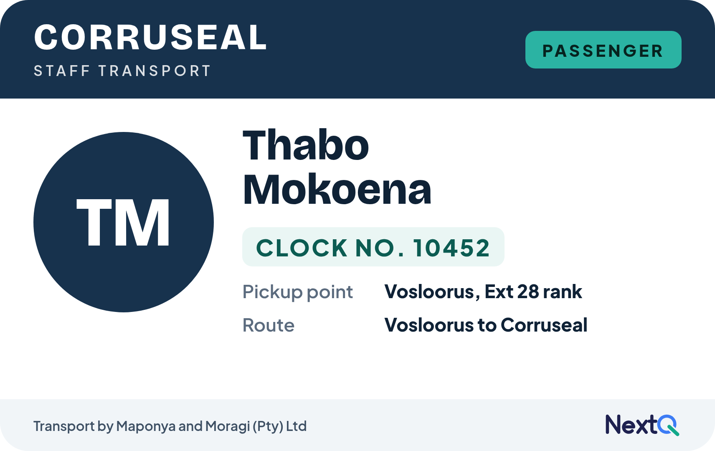
Option two: without a photo
With photo
Driver can see the card belongs to the person
Needs a photo of every employee
More setup before the cards can be printed
Without photo
Lower cost and faster to issue
New staff get a card the same day
A card could be used by someone else
Same back, same QR. The initials take the place of the photo and the clock number is larger.

Slide 8
Privacy and lost cards
1
The QR holds only a number
2
No home address on the card
A random passenger ID such as 7K4M 2Q9P. No name, address or ID number is inside it; the app looks the person up in the secure system.
A lost card cannot lead anyone to an employee's home. The address stays in the system, in line with POPIA. The card shows the pickup point instead.
3
Lost or damaged card
4
History stays whole
The administrator cancels the old card and prints a new one with a new number. The old card stops working at once.
Every employee keeps one permanent record behind the card, so trips before and after a new card stay together.

Slide 9
What we suggest for Corruseal
Explicit Board and Drop off
Works with no signal
A check letter in the number
The driver chooses the action before scanning. A double scan shows "already on board" instead of signing the person out.
Scans are saved on the device and sent as soon as there is signal, like the tablet does today.
The last character of the card number checks the rest, so a typing mistake is caught at once.
Cards printed from the portal
Expected list per vehicle
Security scans at the gate
Import the employee list, then print a PDF sheet of cards. Reprint or replace any card in one click.
Each route carries its expected passengers, so the driver and Corruseal see who is missing before departure.
The officer can scan the same cards at drop off, feeding the existing security sign out confirmation.

Slide 10

Next steps
A short pilot on one vehicle, then all six
1. Corruseal sends the employee list: name, clock number, pickup point and route
2. Choose the card: with photo or without
3. We build QR mode and card printing into NextQ
4. Pilot on one vehicle for a week, then roll out
+27 12 004 3348 · info@nextq.co.za · www.nextq.co.za · South Africa

